Slide 1
Investigating the 3rd Party Android Apps
Kik
Notes:
https://digitalcorpora.s3.amazonaws.com/corpora/mobile/android_10/Non-Cellebrite%20Extraction/Pixel%203.zip

Slide 2
Background

Slide 3
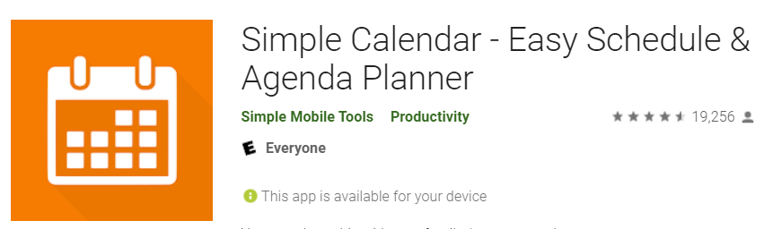
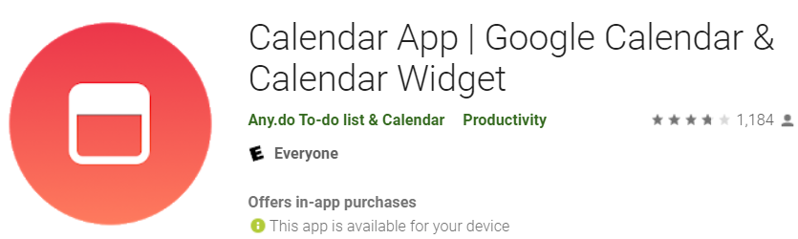
What is 3rd Party Android Apps?
A third-party app is a software application made by someone other than the manufacturer of a mobile device or its operating system.
e.g., app development companies or individual developers create a lot of applications for Apple’s or Google’s operating systems.
Example
com.appgenix.bizcal
com.simplemobiletools.calendar
Notes:
https://android.googlesource.com/platform/packages/apps/
https://android-developers.googleblog.com/2019/03/aosp-application-updates.html

Slide 4
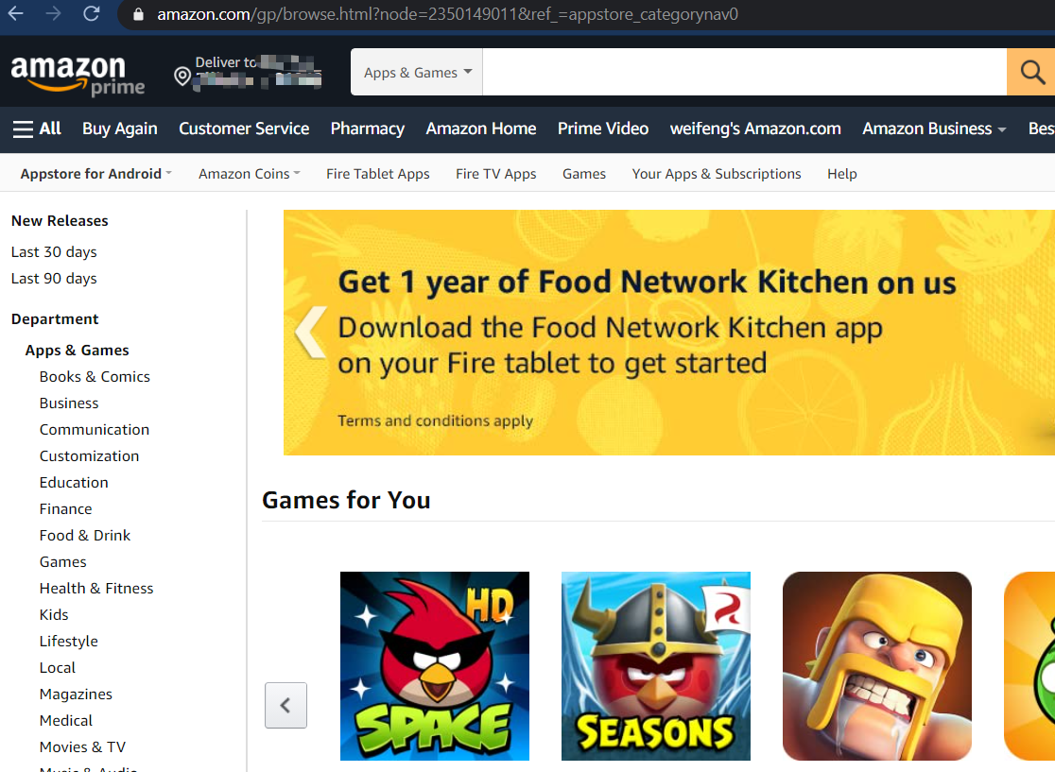

3rd Party App Store for Android
Amazon Appstore
APKMirror
APKPure
APKUpdater
Aptoide
F-Droid
Humble Bundle
QooApp
Samsung Galaxy Apps
Yalp Store

Slide 5
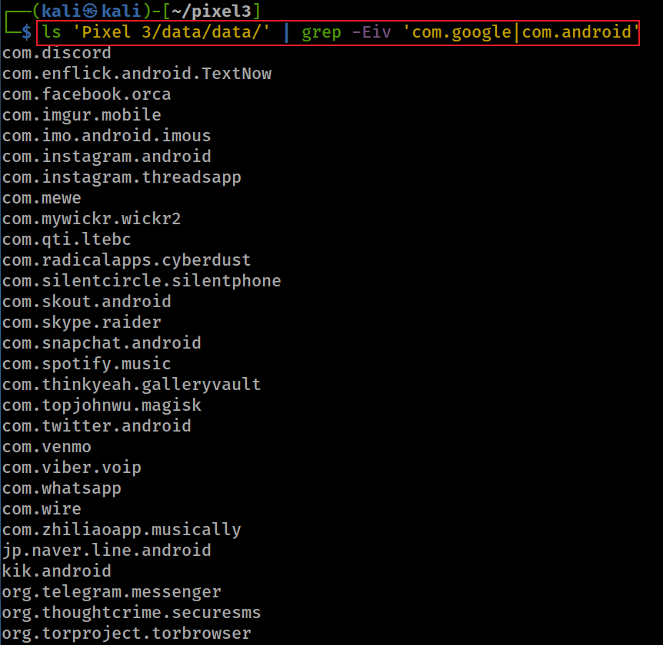
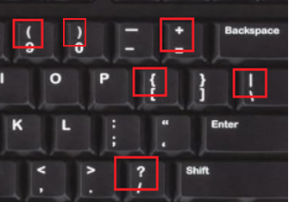
Show all 3rd apps ( apps except AOSP and Google apps)
-E: extended regular expressions
-v, --invert-match select non-matching lines
| : or
In basic regular expressions these characters lose their special meaning; instead use the backslashed versions ‘\?’, ‘\+’, ‘\{’, ‘\|’, ‘\(’, and ‘\)’.
Notes:
ls 'Pixel 3/data/data/' | grep -Eiv 'com.google|com.android’
com.discord
com.enflick.android.TextNow
com.facebook.orca
com.imgur.mobile
com.imo.android.imous
com.instagram.android
com.instagram.threadsapp
com.mewe
com.mywickr.wickr2
com.qti.ltebc
com.radicalapps.cyberdust
com.silentcircle.silentphone
com.skout.android
com.skype.raider
com.snapchat.android
com.spotify.music
com.thinkyeah.galleryvault
com.topjohnwu.magisk
com.twitter.android
com.venmo
com.viber.voip
com.whatsapp
com.wire
com.zhiliaoapp.musically
jp.naver.line.android
kik.android
org.telegram.messenger
org.thoughtcrime.securesms
org.torproject.torbrowser

Slide 6
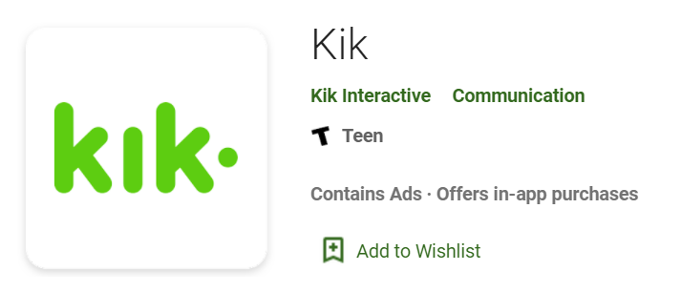

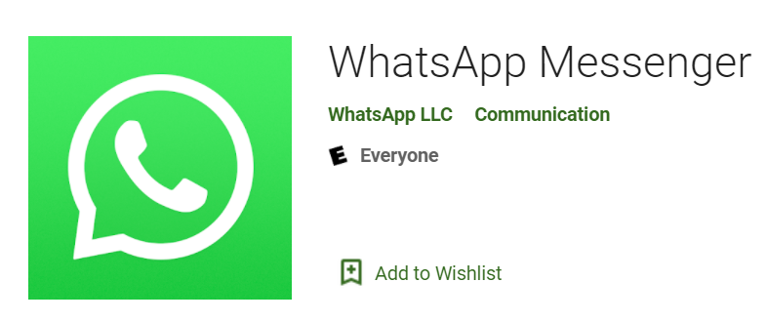
Goal: Analysis of three 3rd Party Apps
Investigating Kik app
com.kik.android
Investigating TextNow app
com.enflick.android.textnow
Investigating whatsapp app
com.whatsapp

Slide 7
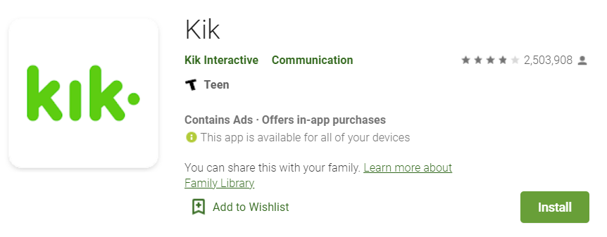
Investigating Kik app

Slide 8
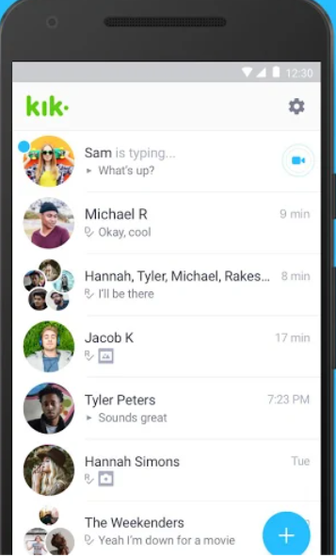
What is Kik app?
Kik is an instant messaging app
One-on-one/in-groups chat
Share pics, videos, gifs, games, etc
Meet new friends with similar interests
Main attraction
anonymity: no need for a phone number
Evidence types
Username
Messages
Last login time
Email associated with app
Install date
Version
Used by teenagers and young adults

Slide 9
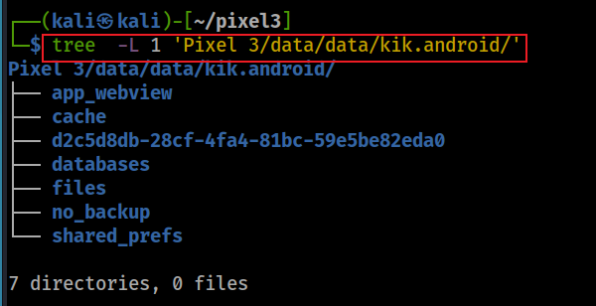
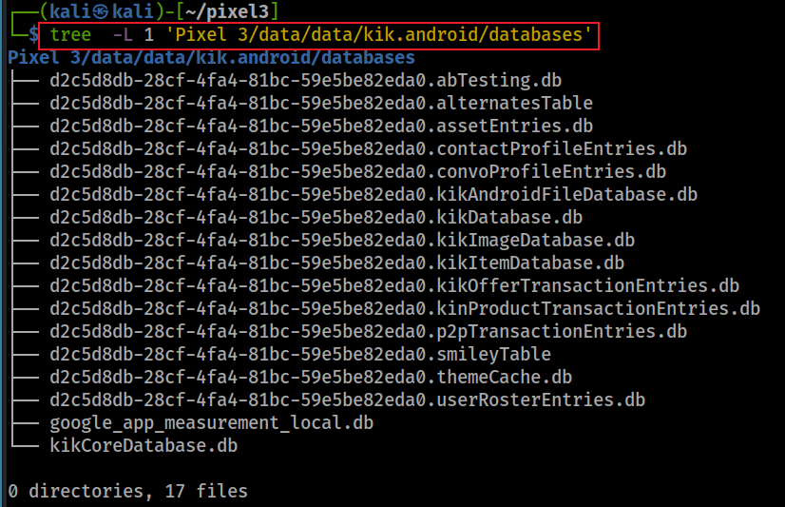
databases of kik
Notes:
tree -L 1 'Pixel 3/data/data/kik.android/’
tree -L 1 'Pixel 3/data/data/kik.android/databases'

Slide 10
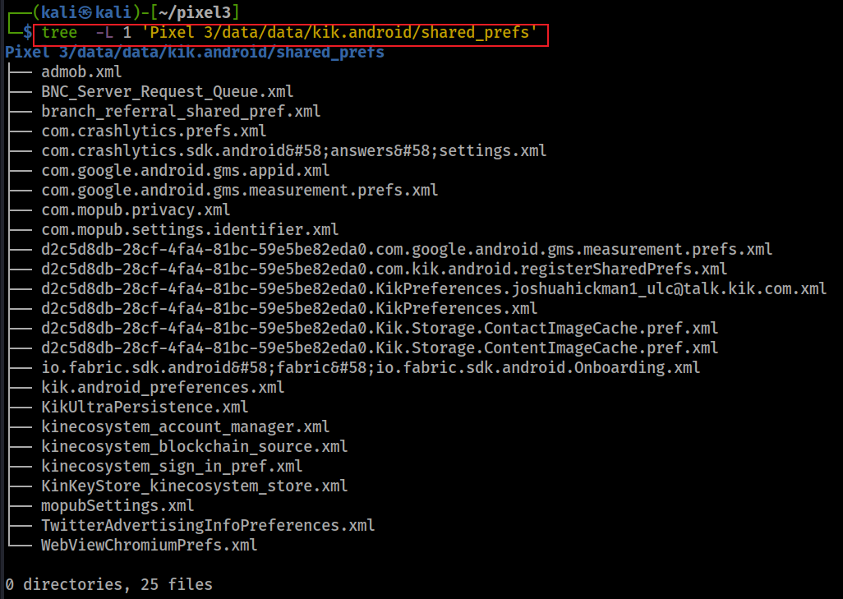
shared_prefs of kik

Slide 11
Scenario
A suspect installed Kik app
Questions
When was the app installed?
What is the version of the app?
What is the Kik username ?
What email is associated with Kik account?
When did the suspect last login into the app?
What are saved conversations?

Slide 12
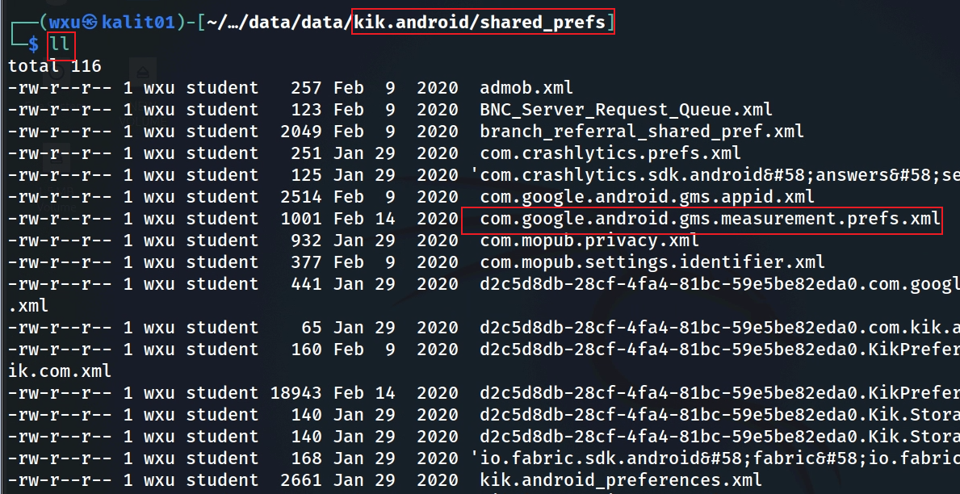
When was the app installed?
timestamp is here, but what is this?
Notes:
Cmd: ls 'Pixel 3/data/data/kik.android' (directory)
Cmd: ls 'Pixel 3/data/data/kik.android/shared_prefs'

Slide 13
What is com.google.android.gms.measurement?
The module is part of the Google Play Services library, specifically tied to Firebase Analytics (formerly Google Analytics for Mobile).
It handles data collection and reporting for app usage, events, and user behavior.
Purpose: It allows apps like Kik to track user interactions (e.g., app opens, button clicks, session duration) and send this data to Firebase Analytics for analysis.
It’s commonly used for understanding user engagement, debugging, and improving app features.
Service: The AppMeasurementService (a service within this package) is responsible for processing and uploading analytics data.

Slide 14
What is com.google.android.gms.measurement.prefs.xml?
The measurement module creates the file.
com.google.android.gms.measurement
stores small amounts of primitive data (e.g., strings, integers, booleans) as key-value pairs in an XML format.
Purpose of the File: It stores configuration settings, state information, or temporary data needed by the measurement module to function within the Kik app.
timestamps (installation, first open, last activity), identifiers (app ID, instance ID), and usage flags.
Limitation: focuses on metadata rather than user-generated content, limiting its overall significance in a forensic investigation.

Slide 15
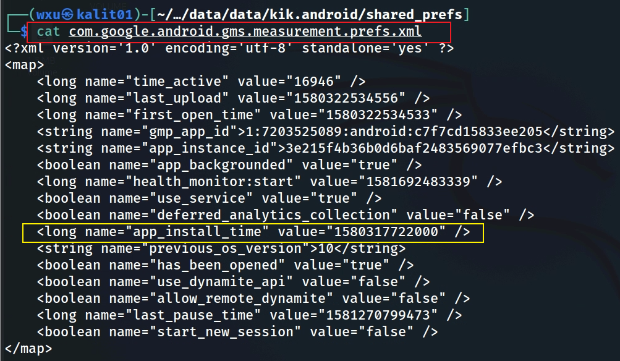
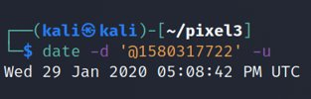
Search for installation timestamp
offering a timeline of app usage (e.g., installed on January 29, 2020, last active on February 9, 2020) and behavioral insights (e.g., minimal usage, analytics enabled).
Notes:
Cmd: cat 'Pixel 3/data/data/kik.android/shared_prefs/com.google.android.gms.measurement.prefs.xml'
Date cmd: date –d '@1580317722' -u

Slide 16
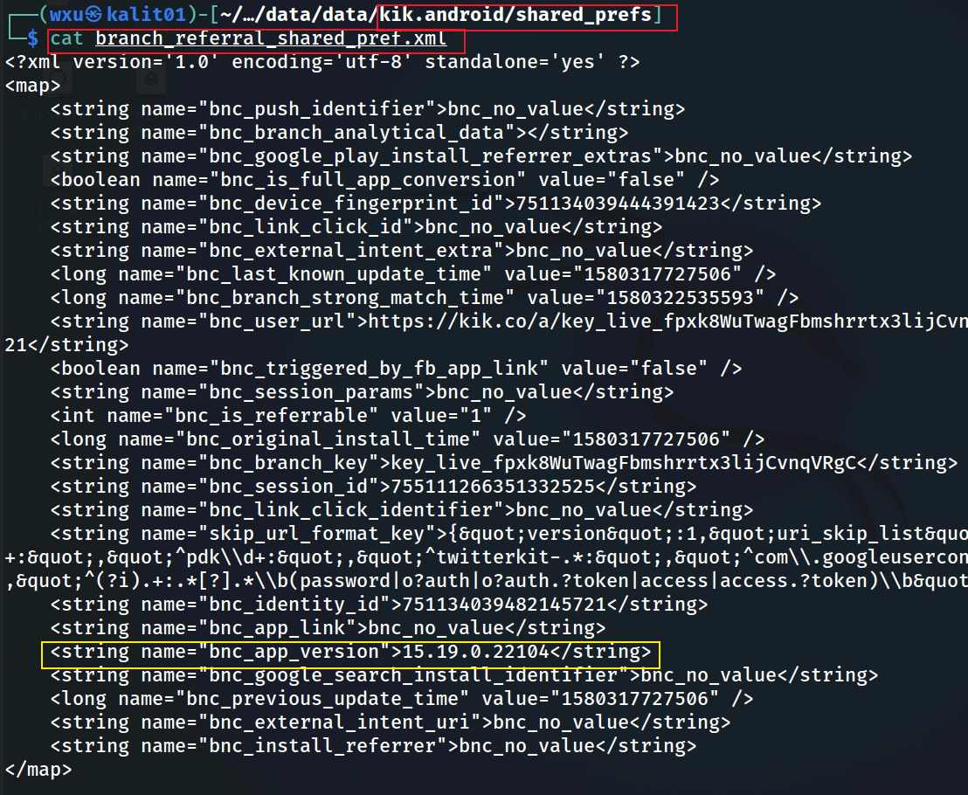
What is kik version?
bnc: Branch
Notes:
└─$ cat branch_referral_shared_pref.xml
<?xml version='1.0' encoding='utf-8' standalone='yes' ?>
<map>
<string name="bnc_push_identifier">bnc_no_value</string>
<string name="bnc_branch_analytical_data"></string>
<string name="bnc_google_play_install_referrer_extras">bnc_no_value</string>
<boolean name="bnc_is_full_app_conversion" value="false" />
<string name="bnc_device_fingerprint_id">751134039444391423</string>
<string name="bnc_link_click_id">bnc_no_value</string>
<string name="bnc_external_intent_extra">bnc_no_value</string>
<long name="bnc_last_known_update_time" value="1580317727506" />
<long name="bnc_branch_strong_match_time" value="1580322535593" />
<string name="bnc_user_url">https://kik.co/a/key_live_fpxk8WuTwagFbmshrrtx3lijCvnqVRgC?%24identity_id=751134039482145721</string>
<boolean name="bnc_triggered_by_fb_app_link" value="false" />
<string name="bnc_session_params">bnc_no_value</string>
<int name="bnc_is_referrable" value="1" />
<long name="bnc_original_install_time" value="1580317727506" />
<string name="bnc_branch_key">key_live_fpxk8WuTwagFbmshrrtx3lijCvnqVRgC</string>
<string name="bnc_session_id">755111266351332525</string>
<string name="bnc_link_click_identifier">bnc_no_value</string>
<string name="skip_url_format_key">{&quot;version&quot;:1,&quot;uri_skip_list&quot;:[&quot;^fb\\d+:&quot;,&quot;^li\\d+:&quot;,&quot;^pdk\\d+:&quot;,&quot;^twitterkit-.*:&quot;,&quot;^com\\.googleusercontent\\.apps\\.\\d+-.*:\\\/oauth&quot;,&quot;^(?i).+:.*[?].*\\b(password|o?auth|o?auth.?token|access|access.?token)\\b&quot;]}</string>
<string name="bnc_identity_id">751134039482145721</string>
<string name="bnc_app_link">bnc_no_value</string>
<string name="bnc_app_version">15.19.0.22104</string>
<string name="bnc_google_search_install_identifier">bnc_no_value</string>
<long name="bnc_previous_update_time" value="1580317727506" />
<string name="bnc_external_intent_uri">bnc_no_value</string>
<string name="bnc_install_referrer">bnc_no_value</string>
</map>

Slide 17
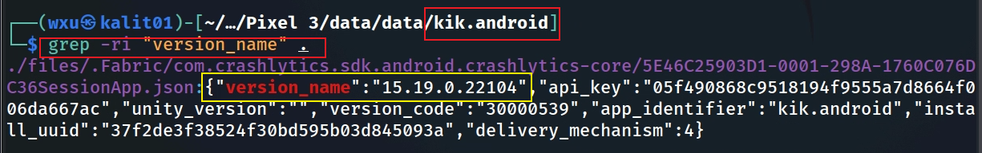
What is the version?
crash report contains the version information.
Note this is not the only way to find the version number.
Notes:
Cmd: cd 'Pixel 3/data/data/kik.android/'
Grep cmd: grep –r 'version'

Slide 18
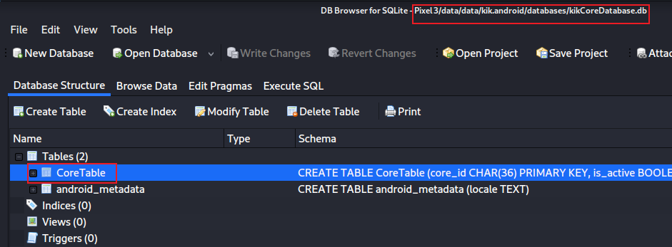
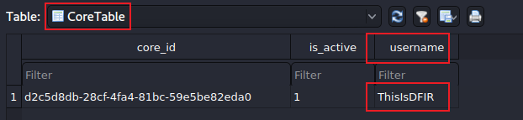
What is the Kik username ?
Open kikCoreDatabase
Exam CoreTable
id for the user
Notes:
sqlitebrowser 'Pixel 3/data/data/kik.android/databases/kikCoreDatabase.db'
cd 'Pixel 3/data/data/kik.android/’
grep –r username
d2c5d8db-28cf-4fa4-81bc-59e5be82eda0

Slide 19
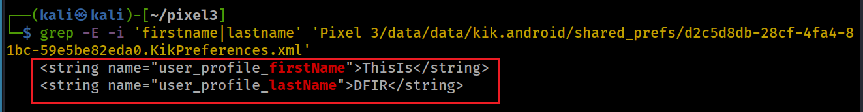
What registered name is associated with Kik account?
id for the user
Search for name keyword using grep

Slide 20
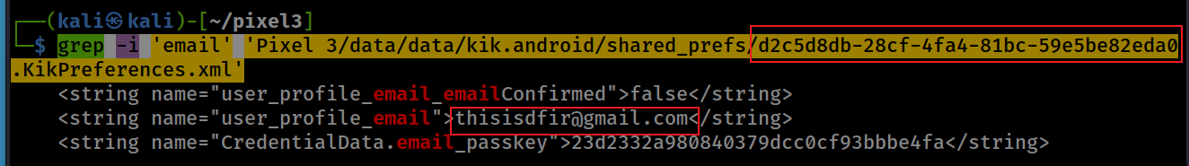
What email is associated with Kik account?
Search for email keyword using grep
Email: thisisdfir@gmail.com
Notes:
grep -i 'email' 'Pixel 3/data/data/kik.android/shared_prefs/d2c5d8db-28cf-4fa4-81bc-59e5be82eda0.KikPreferences.xml'

Slide 21
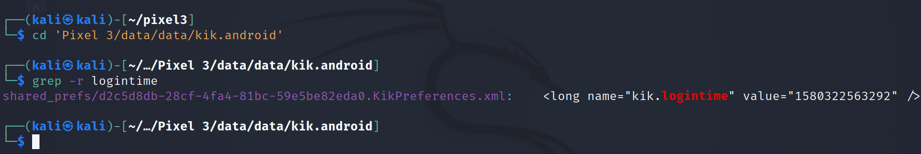
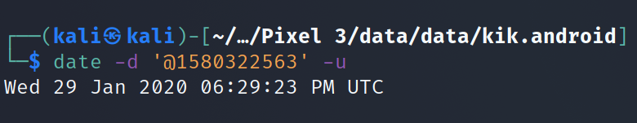
When did the user last log on?
Find the location of the package/folder
Search for keyword. Note we simply use grep to search all files in the directory
Notes:
Cmd: cd 'Pixel 3/data/data/kik.android'
Grep cmd: grep –r logintime
Date cmd: date –d '@1580322563' -u

Slide 22




What are saved conversations?
Approach to answer the question

Slide 23
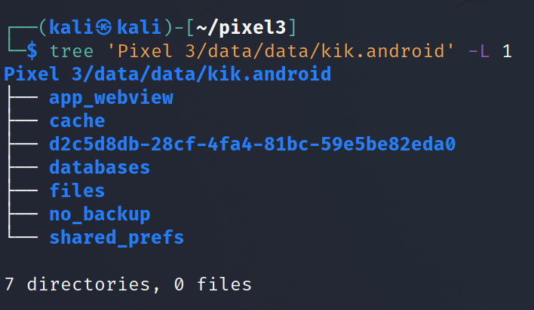
Step 1: find the potential location where conversations are stored
Find the java package
Notes:
Cmd: tree 'Pixel 3/data/data/kik.android' -L 1

Slide 24
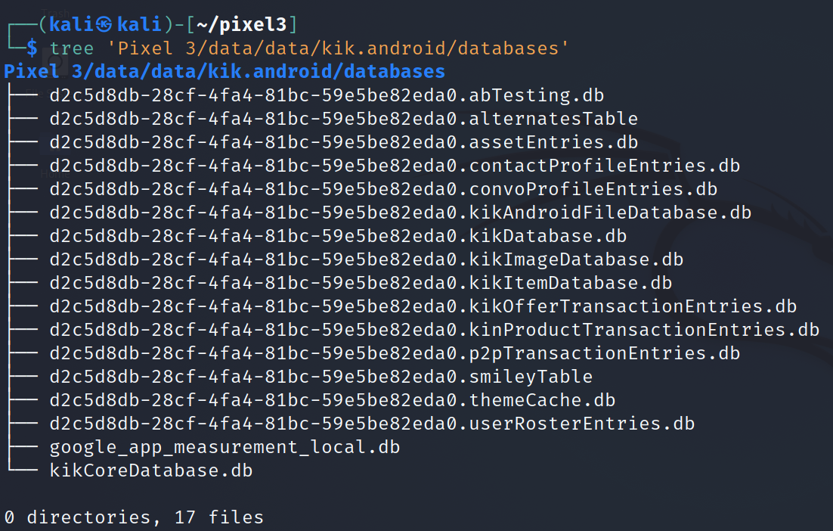
Step 2: find the database that contains messages
Look at the database list
Pay attention to the naming conversion:
coreID.otherdatabase.db
Notes:
Cmd: tree 'Pixel 3/data/data/kik.android/databases'

Slide 25
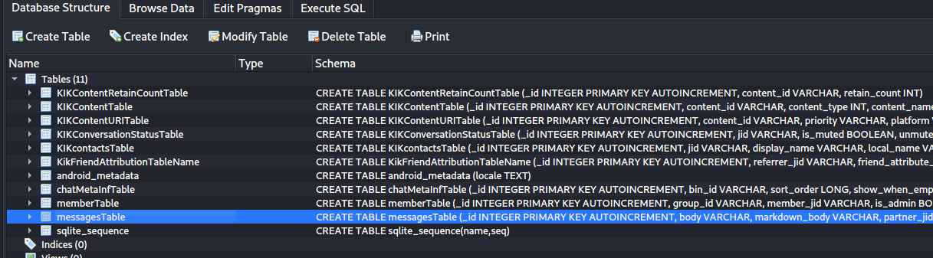
Step 3: Examine the database
Open KikDatabase.db to look at the tables

Slide 26
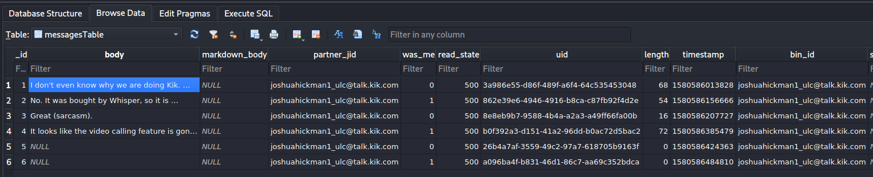
Step 4: find messages
Open messages table and look at the data in each column
communicating partner jabber id
indicates it was sent or received message
0: received from others
1: owner
500: read
400: unread
200: unknown
300:sent undelivered
message content
what are these? (content other than text messages) =>next slide

Slide 27
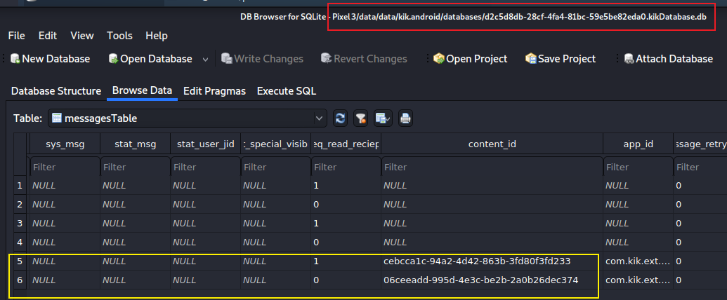
Step 4: find other types of messages (transferred files) based on content_id
Find other types of messages based on content_id
Notes:
06ceeadd-995d-4e3c-be2b-2a0b26dec374.jpg
cebcca1c-94a2-4d42-863b-3fd80f3fd233.jpg

Slide 28
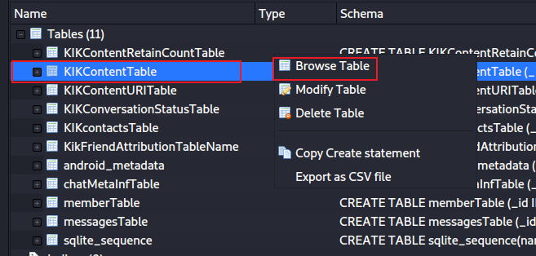
Find transferred file content based on content_id

Slide 29
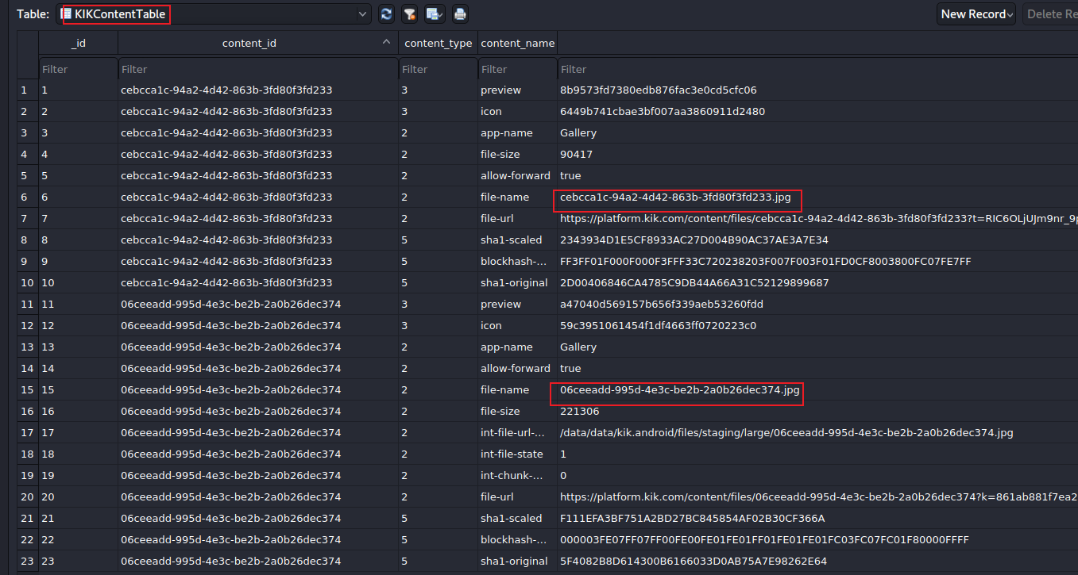
Find transferred jpg
can we retrieve images?
Notes:
/data/data/kik.android/files/staging/large/-I

Slide 30
Can we retrieve images?
We checked the urls and local disk. Nothing were found.
Notes:
https://platform.kik.com/content/files/06ceeadd-995d-4e3c-be2b-2a0b26dec374?k=861ab881f7ea206f63d02586236b22b801af502b
https://platform.kik.com/content/files/cebcca1c-94a2-4d42-863b-3fd80f3fd233?t=RIC6OLjUJm9nr_9pRoRark_QO4Y1cR13CKjm8JRrP3ko0_0yywYhlAdzGYc4MEr6Ag183Hi_9JD69c1_lsCfzfNE51l0n-1O1c4g1n_sW2FSLVxodUGQ_jMSzc8vXjec

Slide 31
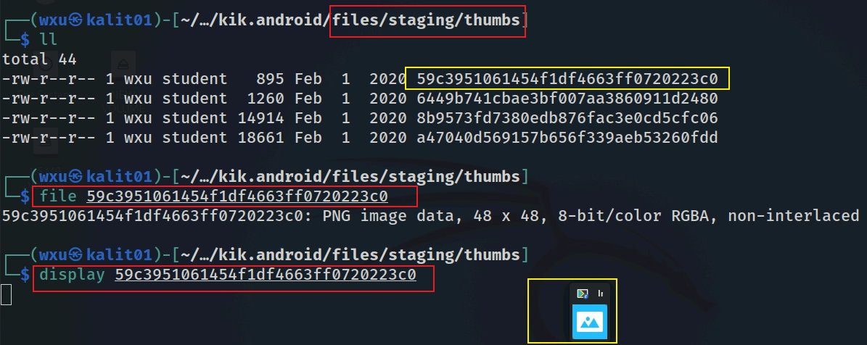
We retrieve thumb of the picture

Slide 32
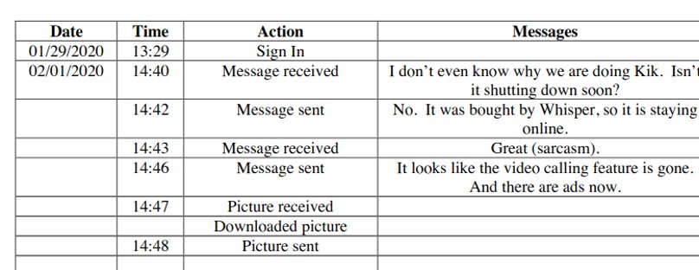
Results of messages

Slide 33
To summarize
Understand the application
Locate the app directory
Search the keywords username, logintime, email, version to get that info
Go to the databases directory
KikCoreDatabase.db has a unique ID for each user
other databases are generated based on ID
Go to shared prefs folder to find the install date of the app

Slide 34
Notes: Using ADB to access files (bash)
adb shell
run-as kik.android
chmod 777 shared_prefs/com.google.android.gms.measurement.prefs.xml
cp /data/data/kik.android/shared_prefs/com.google.android.gms.measurement.prefs.xml /sdcard
exit
adb pull /sdcard/com.google.android.gms.measurement.prefs.xml
Only works for Non-Rooted Devices with Debuggable App

